Slide 1

教学辅助课件
牛津 七年级下

Slide 2



Unit 5
Amazing things
Task

Slide 3





Words and phrases review
sandwich
all over the world
by
per
at least
as…as
inch
ask for
n. 三明治
遍及全世界
prep. 不迟于，
在……之前
prep. 每，每一
至少
像……一样
n. 英寸
请求；要
Read after the tape and speak out the Chinese immediately.

Slide 4
Objectives
To learn to write an article about amazing things
To learn some key words and useful expressions: sandwich, by, per, inch play cards, as…as

Slide 5
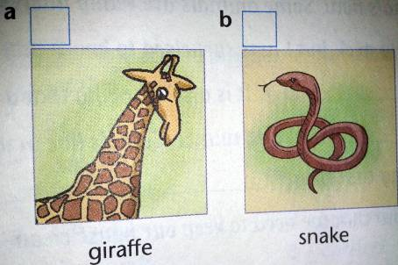
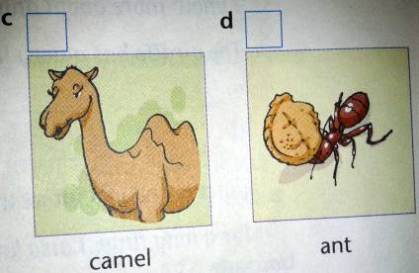
Review
a giraffe — has a very long neck
only __________ in its
long neck
a snake — lives on the ground, in trees
or in water
eats little or nothing for
months _____________
camels — live in very dry places
can live without ______ for a
long time
ants — can ______ things well
seven bones
Amazing!
in cold winter
water
Simon collected some information about amazing things. Let's go and see.
smell

Slide 6
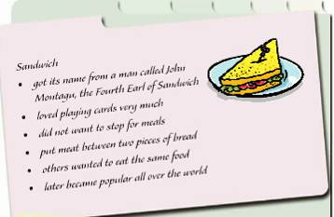
Read the picture and information about Sandwich on page 66 and answer the questions.
(open)
Do you like eating sandwiches?
Where did “sandwich” get its name from?
What did the man love doing?
How did he make a sandwich?
It got its name from a man called John Montagu, the Fourth Earl of Sandwich.
He loved playing cards.
He put meat between two pieces of bread.

Slide 7
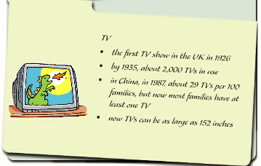
Read the picture and information about TV on page 66 and answer the questions.
(open)
Does your family have a TV?
How many TVs do you have?
When and where was the first TV show?
How many TVs were in use per 100 Chinese families in 1987?
How big can TVs be now?
(open)
It was in the UK in 1926.
About 29.
They can be as large as 152 inches.

Slide 8

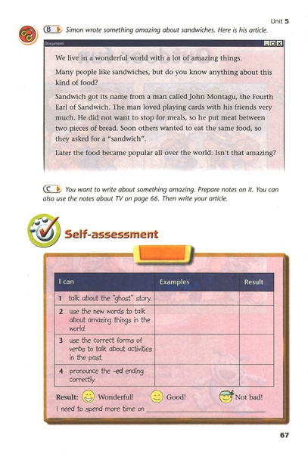
Simon wrote an article about sandwiches. Read and tell what Simon talks about in each paragraph.
introduction
the theme
facts about sandwiches
feeling

Slide 9
Summary
How to write about something amazing?
Introduction
Our world is full of amazing things.
The theme
I think many people like …, but do you
know anything about…?
Facts
1. …; 2. …; 3. …; 4. …; 5. ….
Feeling
…. Isn’t that amazing?

Slide 10
C
You want to write about something amazing. Prepare notes on it. You can also use the notes about TV on page 66. then write your article. (P 67)
Sample writing:
introduction
We live in a world with a lot of interesting things.
I think most of you like watching TV, but do you know anything about TV?
The first TV show was in the UK in 1926. By 1935, there were only 2,000 TVs in use. In China, there were about 19 TVs per 100 families in 1987. The number grew very fast. Now most families have
at least one TV.
In the past, TVs were small, but now they can be as large as 152 inches. Isn’t that cool?
the theme
facts
feeling

Slide 11
Language points
Now TVs can be as large as 152 inches.
as … as 意为“像……一样”，表示前后两者在某方面程度相同，两个as中间要用形容词或副词的原级。
①This story is as funny as that one.
这个故事和那个故事一样好笑。
②Jack listens as carefully as Mike in class.
课堂上杰克和迈克听得一样认真。

Slide 12


Homework
1. Finish the writing exercises in Learning English.
2. Preview Outdoor fun on page 68.

